Slide 1

COLLEGE OF COMPUTING AND INFORMATION SCIENCES (CoCIS).
DEPARTMENT OF COMPUTER SCIENCE
Course Unit: MCS 7103 – Machine Learning.
SEMISTER PROJECT
Topic: Coffee Disease Detection using Image Classification
Presented by:
MAKERERE UNIVERSITY
STUDENT NAME | STUDENT NUMBER | REGISTRATION NUMBER
GRACE. RONALD. SEMWEZI | 2500726370 | 2025/HD05/26370U

Slide 2
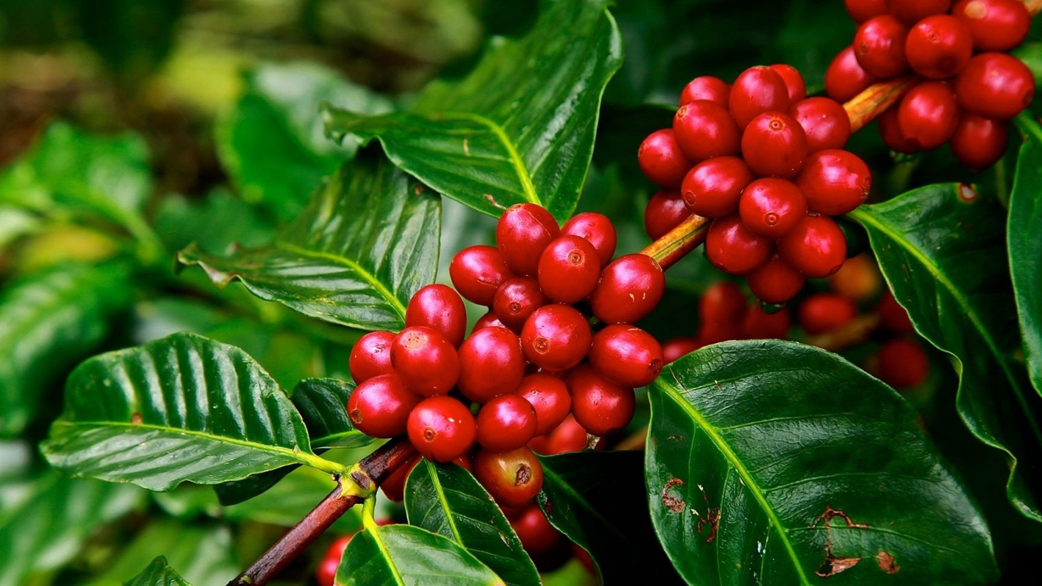
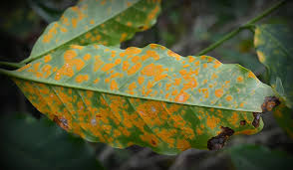
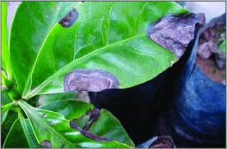
Coffee Disease Detection using Image Classification

Slide 3
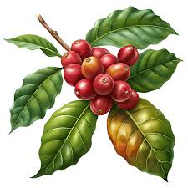
Introduction
Coffee is not only a globally cherished beverage but also a vital agricultural commodity, supporting the livelihoods of millions of farmers and contributing significantly to the economies of producing countries. However, coffee crops are persistently threatened by a range of diseases, notably leaf rust (Hemileia vastatrix) and Phoma, which can cause devastating yield losses if not detected and managed promptly.
Traditional disease identification methods rely on manual inspection, which is labor-intensive, subjective, and often infeasible at scale.
In recent years, deep learning—particularly Convolutional Neural Networks (CNNs)—has emerged as a transformative technology for automating plant disease detection from images, offering high accuracy and scalability.
Among CNN architectures, MobileNetV2 stands out for its efficiency and suitability for deployment on resource-constrained devices such as smartphones, making it ideal for field applications in agriculture.
This report presents a comprehensive, reproducible, and deployment-ready Python implementation for coffee disease detection using MobileNetV2 in TensorFlow and Keras. The system is designed to classify coffee leaf images into three categories: Healthy, Rust, and Phoma.

Slide 4
Project Overview and Objectives
The primary objective of this project is to develop a robust, efficient, and interpretable AI system for the automated detection of coffee leaf diseases using image data.
The system leverages transfer learning with MobileNetV2 pretrained on ImageNet, fine-tuned for the specific task of classifying images into three categories: Healthy, Rust, and Phoma.
The system is intended for use by researchers, agronomists, and developers aiming to deploy coffee disease detection solutions in real-world settings, including mobile and edge devices.

Slide 5
Data Structure and Recommended Directory Layout
A well-organized dataset is foundational for effective model training and evaluation. The recommended directory structure for image classification tasks using TensorFlow and Keras is as follows:
train/: Contains images for model training, organized by class.
val/: Contains images for validation during training, used for hyperparameter tuning and early stopping.
test/: Contains images for final model evaluation, ensuring unbiased performance metrics.
This structure is compatible with tf.keras.utils.image_dataset_from_directory, which infers class labels from subdirectory names. The dataset was split into training, validation, and test sets, typically using ratios 60:20:20, ensuring class balance where possible.

Slide 6
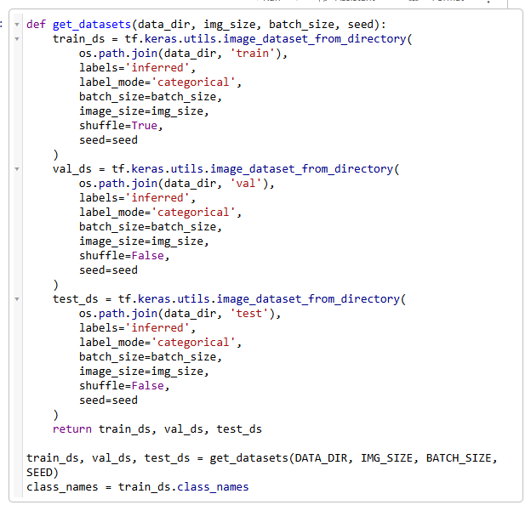
Data Loading with: tf.keras.utils.image_dataset_from_directory
TensorFlow's image_dataset_from_directory utility was used to streamline the process of loading and batching image data for model training.
This approach ensured efficient data loading, automatic label assignment, and compatibility with Keras model training workflows.

Slide 7
Image Preprocessing and MobileNetV2 Input Requirements
MobileNetV2 expected input images of shape (224, 224, 3) with pixel values scaled to the range [-1, 1]. Preprocessing steps include:
Resizing: All images were resized to 224x224 pixels.
Normalization: Pixel values were scaled from [0, 255] to [-1, 1] using tf.keras.applications.mobilenet_v2.preprocess_input.
Batching and Prefetching: Datasets are batched and prefetched for optimal performance.
Including the preprocessing step in the data pipeline ensures that all images are correctly formatted for MobileNetV2, facilitating transfer learning and consistent model performance.

Slide 8
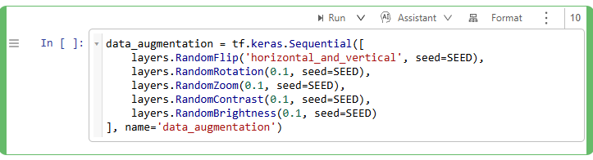
Data Augmentation Techniques and Implementation
Data augmentation is critical for improving model generalization, especially when the dataset is limited or imbalanced. The augmentation techniques used included:
- Random Flipping: Horizontal and vertical flips.
- Random Rotation: Rotating images by small angles.
- Random Zoom: Zooming in or out.
- Random Contrast and Brightness: Adjusting image contrast and brightness.
- Random Translation: Shifting images horizontally or vertically.
TensorFlow provided the preprocessing layers for augmentation, which we included in the model :

Slide 9
Building the Model: MobileNetV2 Base with ImageNet Weights
Why MobileNetV2?
MobileNetV2 is a lightweight, efficient CNN architecture designed for mobile and edge deployment. It employs inverted residual blocks and depthwise separable convolutions, significantly reducing the number of parameters and computational cost without sacrificing accuracy. MobileNetV2 pretrained on ImageNet provides a strong feature extractor for transfer learning in plant disease detection.
Model Construction
The model was constructed by:
Loading MobileNetV2 as the base model with include_top=False to exclude the original classification head.
Freezing the base model during initial training to leverage pretrained features.
Adding a custom classification head tailored to the three target classes.
Optionally unfreezing selected layers for fine-tuning after initial convergence.

Slide 10
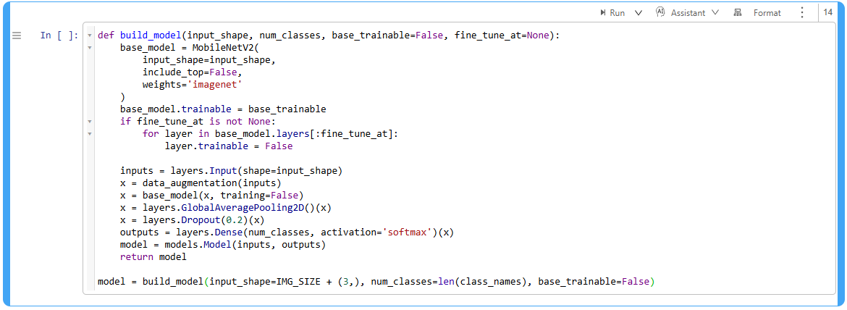
Building the Model: MobileNetV2 Base with ImageNet Weights
This architecture ensures efficient feature extraction and adaptability to the specific coffee disease classification task.

Slide 11
Custom Classification Head Design for 3 Classes
The custom head typically included:
Global Average Pooling: Was used to reduces the spatial dimensions, summarizing feature maps.
Dropout Layer: was used to mitigate overfitting by randomly dropping units during training.
Dense Output Layer: Outputs class probabilities using softmax activation for the three classes (Healthy, Rust, Phoma).
Rationale:
GlobalAveragePooling2D was preferred over flattening as it reduces the risk of overfitting and is more robust to spatial translations.
Dropout (e.g., 0.2) further regularizes the model.
The Dense layer with units=3 and activation='softmax' ensured the output matches the number of target classes.

Slide 12
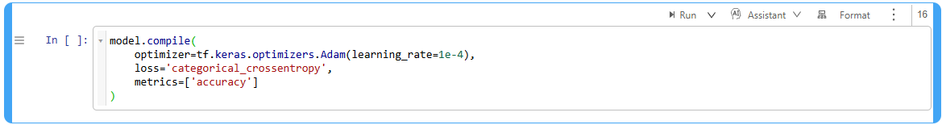
Model Compilation: Loss, Optimizer, Metrics, Learning Rate
Loss Function
Categorical Crossentropy was used for multi-class classification with one-hot encoded labels.
Optimizer
Adam optimizer was used for its adaptive learning rate and robust convergence properties.
Metrics
Accuracy was the primary metric.
Additional metrics like (precision, recall, F1-score) were computed during evaluation.
Learning Rate
A low initial learning rate is applied for transfer learning.
Learning rate schedulers or callbacks were used for dynamic adjustment.

Slide 13
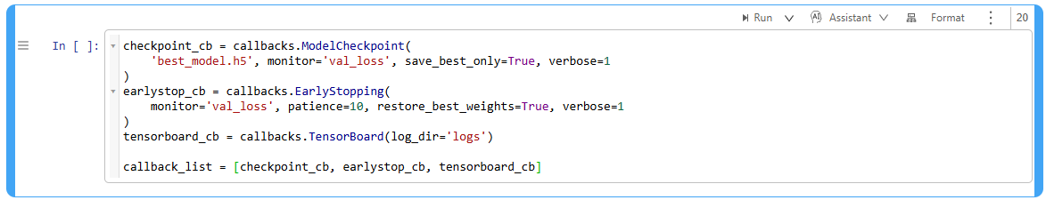
Training Strategy and Callbacks
Training Strategy
Initial Training: Train only the custom head with the base model frozen.
Fine-Tuning: Unfreeze selected layers of the base model and continue training with a lower learning rate.
Callbacks
EarlyStopping: Stops training when validation loss ceases to improve, preventing overfitting and saving resources.
ModelCheckpoint: Saves the best model weights based on validation performance.
TensorBoard: Enables real-time monitoring of training metrics and visualizations.
These callbacks ensured efficient training, model preservation, and insightful monitoring.

Slide 14
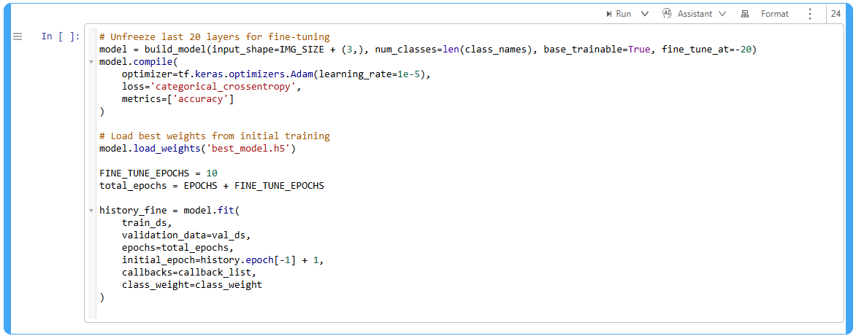
Fine-Tuning Strategy and Layer Unfreezing Schedule
After initial convergence, fine-tuning the base model can yield significant performance gains:
Unfreeze the last N layers of MobileNetV2 (e.g., last 20 layers).
Recompile the model with a lower learning rate (e.g., 1e-5).
Continue training with callbacks.
This approach allowed the model to adapt high-level features to the specific dataset while preserving the general representations learned from ImageNet.

Slide 15
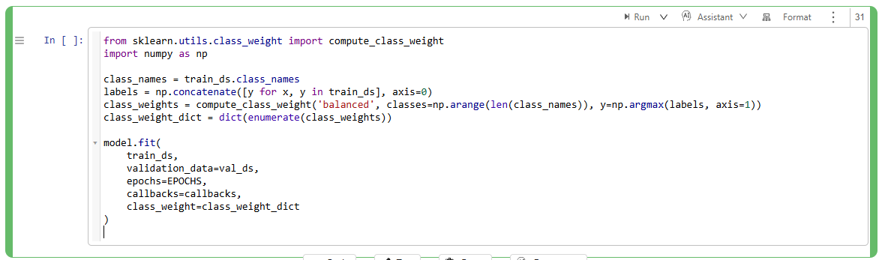
Handling Class Imbalance and Augmentation Strategies
Class imbalance can bias the model toward majority classes, reducing performance on minority classes. Strategies include:
Data Augmentation: Generate more samples for minority classes.
Class Weights: Assign higher loss weights to underrepresented classes during training.
Oversampling: Duplicate minority class samples.
This ensured that the model pays appropriate attention to all classes, improving fairness and robustness.

Slide 16
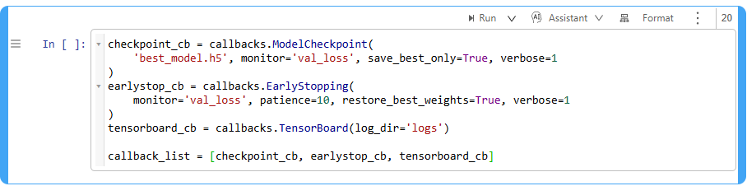
Monitoring Training: TensorBoard Integration and Visualizations
TensorBoard provides powerful tools for monitoring training progress, visualizing metrics, and debugging models:
Scalars: Track loss and accuracy over epochs.
Histograms: Visualize weight distributions.
Images: Display sample inputs and outputs.
Graphs: Inspect model architecture.
This facilitates real-time tracking and post-training analysis, aiding in model optimization and troubleshooting.

Slide 17
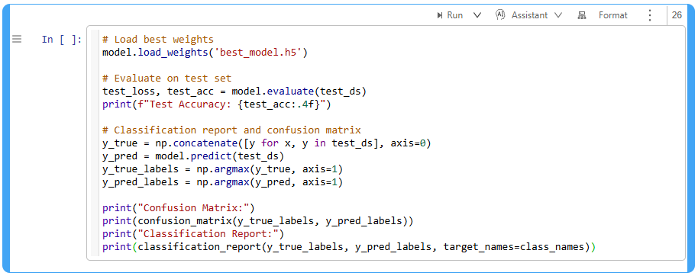
Evaluation: Confusion Matrix, Classification Report, Per-Class Metrics
Comprehensive evaluation was essential for understanding model performance across all classes. Key metrics used included:
Confusion Matrix: Visualizes true vs. predicted labels.
Classification Report: Provides precision, recall, F1-score, and support for each class.
These metrics provided granular insights into the model strengths and weaknesses, guiding further improvements.

Slide 18
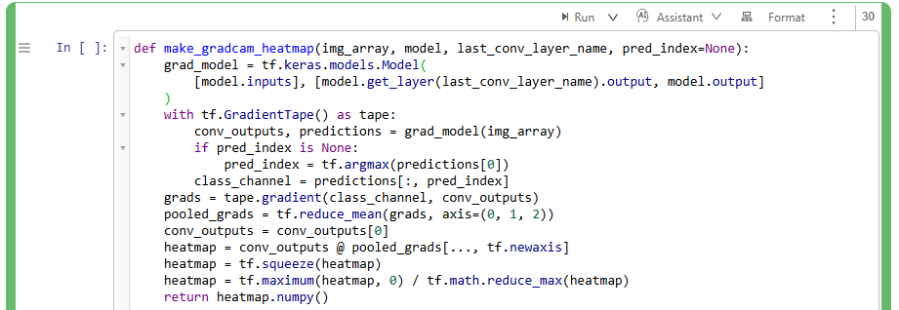
Model Interpretability and Explainability (Grad-CAM)
Deep learning models are often criticized as "black boxes." Grad-CAM (Gradient-weighted Class Activation Mapping) addresses this by visualizing the regions of an image that most influence the model's predictions.
Implementation Steps:
Identify the last convolutional layer in the model.
Compute the gradient of the predicted class with respect to the feature maps.
Weight the feature maps by the computed gradients.
Aggregate and normalize to produce a heatmap.
Overlay the heatmap on the original image for visualization.
Grad-CAM enhances model transparency, aids debugging, and builds user trust, especially in critical applications such as agriculture.

Slide 19
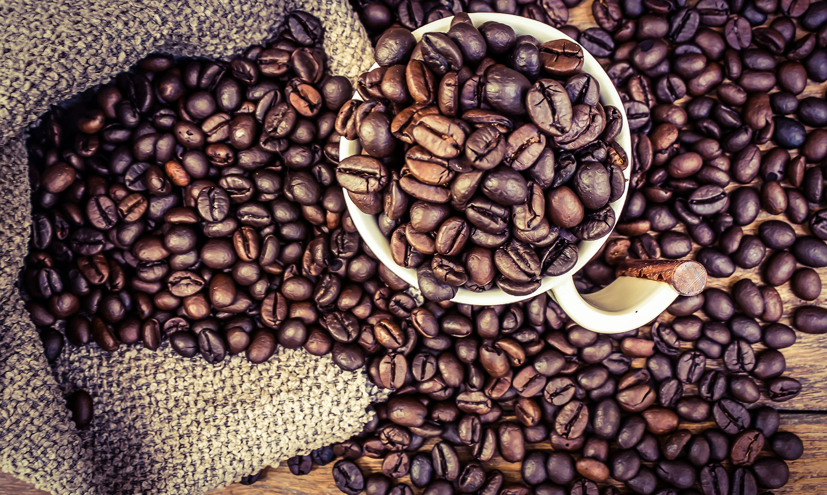
THANK YOU – Enjoy some Coffee

